Slide 1


CARE
Your Health, Our Mission
“Addressing Every Need”

Slide 2

Introduction: Our commitment to your well-being
Our project, iCARE, aims to revolutionize the way patients access healthcare services and how doctors manage their schedulesn today's fast-paced world, finding and scheduling doctor appointments can be a daunting task for patients, while doctors often struggle with managing their appointments efficiently,I CARE addresses this critical issue by offering a user-friendly platform that simplifies the process of finding nearby hospitals, booking appointments online, and providing doctors with a streamlined dashboard to manage their schedules effectively.

Slide 3




Objective:
Objective 1: Enhance Accessibility Objective: Make healthcare services more accessible to patients
Objective 3: Streamline Appointment booking
01
03
Objective: Simplify the process of booking doctor appointments.
How: Implement an efficient appointment booking system accessible to patients 24/7.
.
How: Develop a user-friendly website with a hospital search feature to find nearby medical facilities easily.
Objective 2: Improve Doctor Scheduling
Objective 4: Future Growth
04
Objective: Lay the foundation for future enhancements.
How: Design the platform to be scalable and adaptable to emerging healthcare needs.
02
Objective: Enhance doctors' scheduling and time management.
How: Provide doctors with a dedicated dashboard to view and manage their appointments effortlessly.

Slide 4
CORE FEATURE OF Our Project
1
2
3
Hospital Search:
Google Maps Integration: Users can search for nearby hospitals based on their current location or inputted address.
Interactive Maps: Utilizing the Google Maps API, users can view hospitals on an interactive map with markers and detailed information.
Appointment Booking System: User-Friendly Booking: Patients can easily schedule appointments
with their preferred doctors.
Real-Time Availability: The system provides real-time information on doctor availability, helping patients choose convenient slots.
Doctor's Dashboard:
Comprehensive Information: Doctors have access to a dashboard displaying their booked appointments and available slots.
Efficient Management: The dashboard streamlines appointment management, improving overall efficiency.

Slide 5
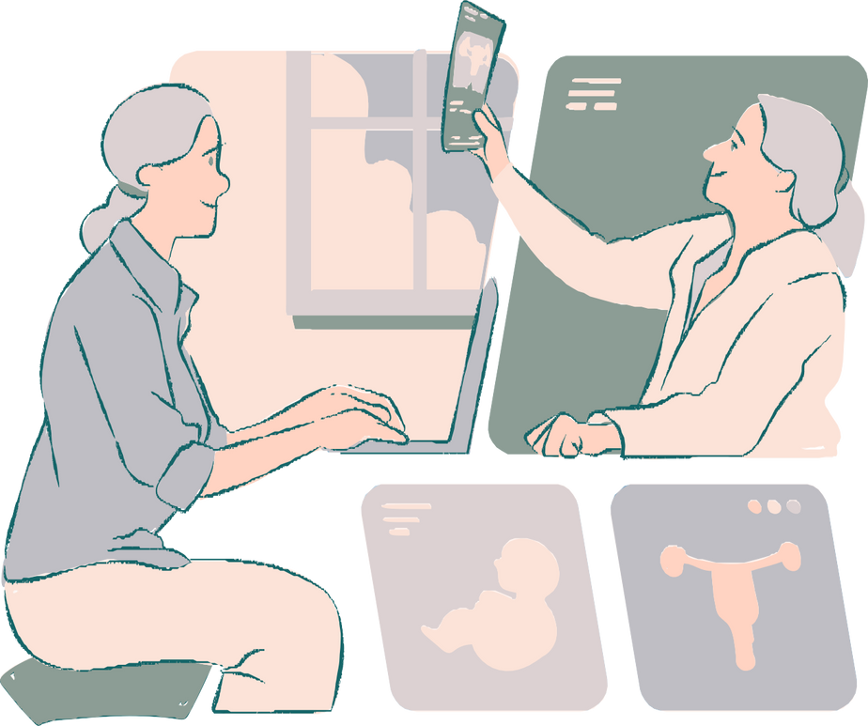
Technology Used
Front-End Development:
HTML5, CSS3, JavaScript: These standard web technologies provide a responsive and user-friendly interface for patients and doctors.
.
React.js: A robust JavaScript library for building interactive user interfaces, ensuring a seamless user experience.
2.Location Services:
Google Maps API: Empowers users to find nearby hospitals based on their location, enhancing accessibility to healthcare services.
3.Authentication:
Face++ API: Ensures secure and efficient doctor authentication during sign-up and login processes, safeguarding sensitive medical data.
4.Database:
SQL: A database for flexible and scalable data storage, facilitating efficient data retrieval and management.
5. Backend Development:
Node.js: A fast and scalable server-side runtime environment for handling server logic and data storage

Slide 6
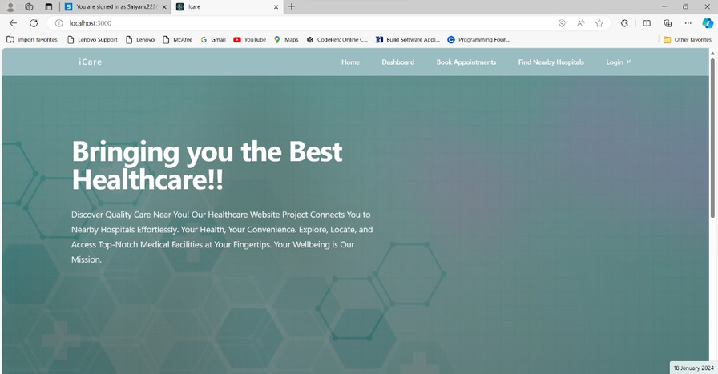
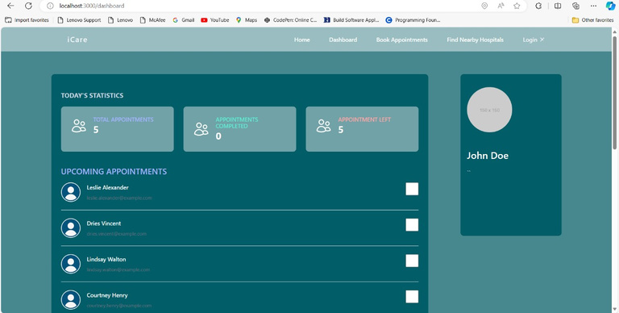
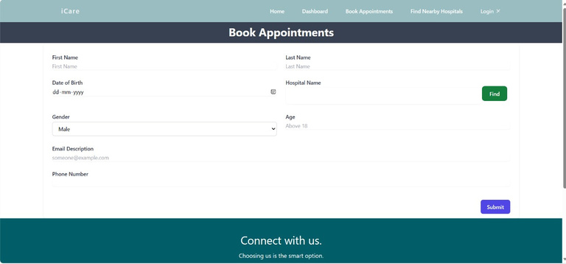
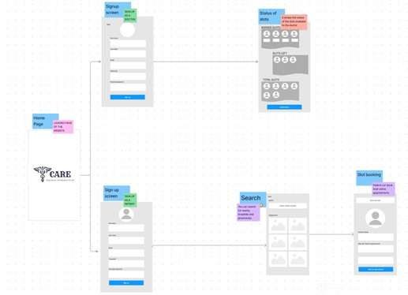
Work Flow Diagram

Slide 7
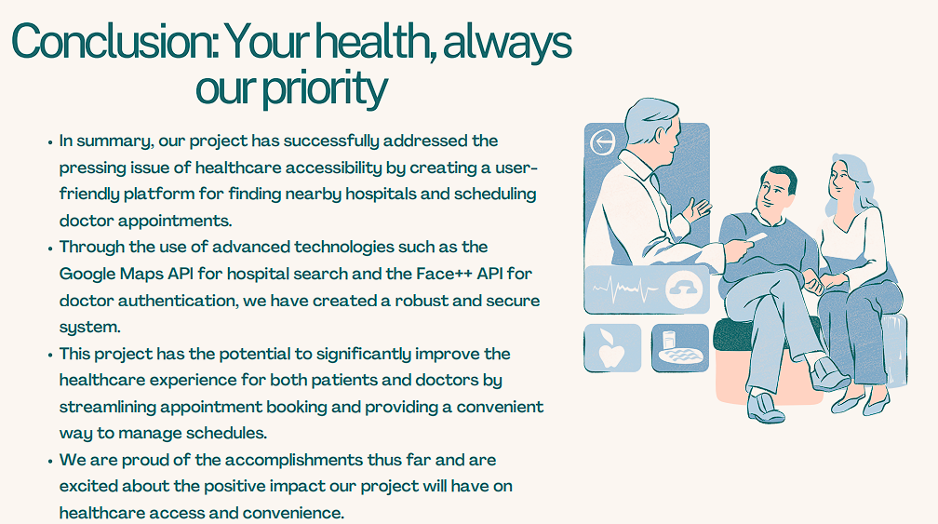

Slide 8
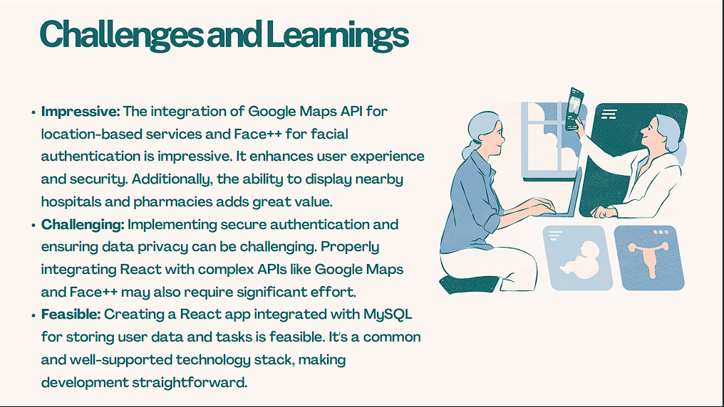

Slide 9
FUTURE SCOPE
Telemedicine Integration:
Explore the integration of telemedicine features, allowing doctors to conduct virtual consultations with patients. This can expand the reach of healthcare services and improve accessibility.
Patient Portal:
Develop a patient portal that allows individuals to schedule appointments, view their medical history, and communicate securely with their healthcare providers. This creates a more comprehensive healthcare ecosystem.
Enhanced Security Measures:
Continuously improve and update the security measures, especially for face authentication. Consider exploring the integration of biometric technologies for additional layers of identity verification.
Mobile App Development:
If not already implemented, consider developing mobile applications for iOS and Android platforms. Mobile apps can enhance user convenience, especially for features like finding nearby hospitals on the go.

Slide 10


